Slide 1


PANIMALAR ENGINEERING COLLEGE
Department of Computer Science and Engineering
CS8811 PROJECT WORK
Title of the project : Classification of hate speech using machine learning with NLP
Project Guide: Dr. M. KRISHNAMOORTHY
Team Members with Register number
MACHA BHARATH M 211419104153
RAHUL C 211419104208
RAKESH R 211419104211
Batch Number: C09

Slide 2
INTRODUCTION
Hate speech is a complex and multifaceted form of harmful or offensive content that targets individuals or groups based on their race, ethnicity, gender, religion, sexual orientation, or other characteristics.
Online toxic discourses could result in conflicts between groups or harm to online communities. Due to the increase in the online social network development in the past few years due to different purposes, hate speech appears in large numbers and the online world has widespread.
In some cases, hate speech can also spread more rapidly than true information, leading to misinformation and a distorted public discourse.
To address the problem of hate speech, there is a need for machine learning models that can detect these speech automatically. Machine learning models are designed to build using algorithms so that they can classify whether a speech is hate speech, offensive speech, or not hate and offensive speech.
The supervised learning method requires a dataset that contains labeled examples of hate speech, offensive speech, and nonoffensive speech. The model is then trained to classify new examples based on the features extracted from the dataset.

Slide 3
LITERATURE SURVEY
S.NO | PAPER NAME | AUTHOR NAME | YEAR
1. | Using Machine Learning for Detection of Hate speech and Offensive Code Mixed Social Media Text | Varsha Pathak, Manish Joshi | 2020
2. | Challenges of Hate Speech Detection in Social Media | Gyorgy, Rajkumar Saini | 2021

Slide 4
TECHNOLOGY STACK
SOFTWARE DESCRIPTION
1. LANGUAGE : PYTHON
2. IDE : ANACONDA
CODING SPECIFICATIONS
1. FRONT END : HTML , CSS
2. BACK END : PYTHON
SOFTWARE REQUIREMENT
1. OPERATING SYSTEM : WINDOWS 10 OR LATER
2. TOOL : ANACONDA WITH JUPYER NOTEBOOK
HARDWARE REQUIREMENT
1. PROCESSOR : PENTIUM IV/III
2. HARD DISK : MINIMUM 80 GB
3. RAM : MINIMUM 2GB

Slide 5
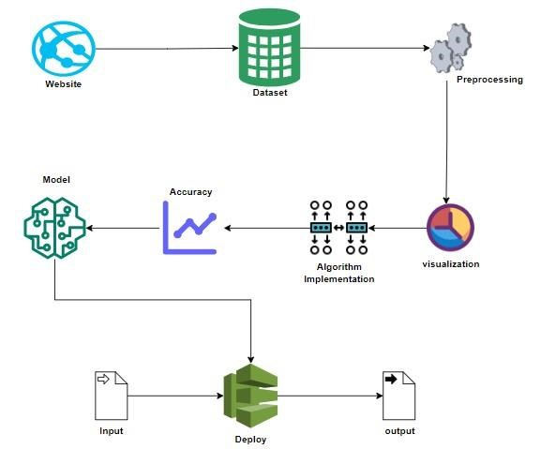
SYSTEM ARCHITECTURE

Slide 6
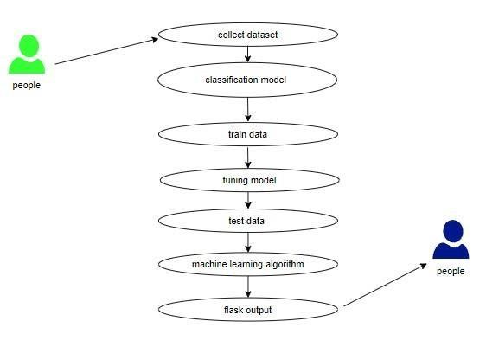
USE CASE DIAGRAM

Slide 7
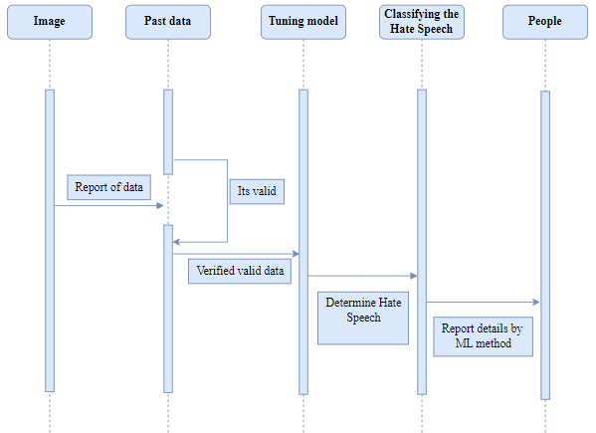
SEQUENCE DIAGRAM

Slide 8
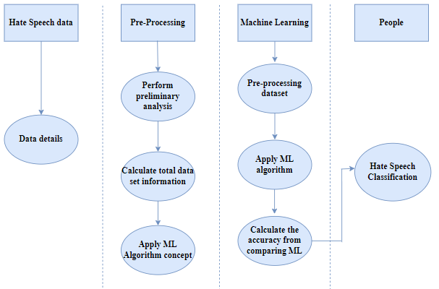
ACTIVITY DIAGRAM

Slide 9
MODULE DESCRIPTION
PYTHON
Python is a high level general-purpose language its object oriented approach aim to help programmers write, clear logical
code for small and large scale projects .
Guido Van Rossum been working on python in late 90’s and first released it in 1991 as Python 0.9.0 .
Python is meant to be easily readable language .
Python includes a modular machine learning library known as PyBrain, which provides easy-to-use algorithms for use in machine learning tasks.
Since machine learning and artificial intelligence involve complex algorithms, the simplicity of Python adds value and enables the creation of reliable systems.
NumPy is regarded as being one of the most widely used and best Python libraries for Machine Learning. Other libraries, such as TensorFlow and Keras, use NumPy to implement various operations on tensors.

Slide 10
HTML
NumPy is regarded as being one of the most widely used and best Python libraries for Machine Learning. Other libraries, such as TensorFlow and Keras, use NumPy to implement various operations on tensors.
NumPy is regarded as being one of the most widely used and best Python libraries for Machine Learning. Other libraries, such as TensorFlow and Keras, use NumPy to implement various operations on tensors.
Html consists of various tags like Head tag , Body tag , Image tag .
The <head> element is a container for metadata (data about data) and is placed between the <html> tag and the <body> tag.
The <body> tag defines the document's body.
HTML <img> tag is used to add image inside webpage/website.
HTML is a markup language so you can use it on webpages because web browser has been supported it. . . HTML is not enough for designing web pages (dynamic pages) you must use CSS & JAVAscript for complete it.

Slide 11
CSS
Cascading Style Sheets (CSS) is a stylesheet language used to describe the presentation of a document written in HTML or XML (including XML dialects such as SVG, MathML or XHTML). CSS describes how elements should be rendered on screen, on paper, in speech, or on other media.
CSS is among the core languages of the open web and is standardized across Web browsers according to W3C specifications.
CSS is used to style and layout web pages just as to alter the font, color, size, and spacing of your content, split it into multiple columns, or add animations and other decorative features.
This module provides a gentle beginning to your path towards CSS mastery with the basics of how it works, what the syntax looks like, and how you can start using it to add styling to HTML..
There are three types of CSS they are
1) INLINE CSS
2) INTERNAL CSS
3) EXTERNAL CSS

Slide 12
ANACONDA
Anaconda is a free and open source distribution of Python and R programming languages .
The Anaconda distribution is used is used by over 12 million users and includes more than 1400 popular data science packages suitable for Windows , OS , Linux .
Anaconda navigator is a Graphical User Interface that allows you to launch application and easily manage conda packages , environments and channel without using command lines .
The following applications are available by default in Anaconda Navigator
1) JupyterLab
2) JupyterNotebook
3) Spyder
4) Pycharm
5) Vscode
6) R Studio

Slide 13
LIST OF MODULES
Data Preprocessing
Data Analysis of Visualization
Comparing Algorithm with Prediction in the form of best Accuracy Result
Deployment using FLASK

Slide 14
FLASK
Flask is a micro web framework written in Python.
It is classified as a micro-framework because it does not require particular tools or libraries.
It has no database abstraction layer, form validation, or any othercomponents where pre-existing third-party libraries provide common functions.
However, flask supports extensions that can add application features as if they were implemented in flask itself.
Extensions exist for object-relational mappers, form validation, upload handling, various open authentication technologies and several common framework related tools.

Slide 15
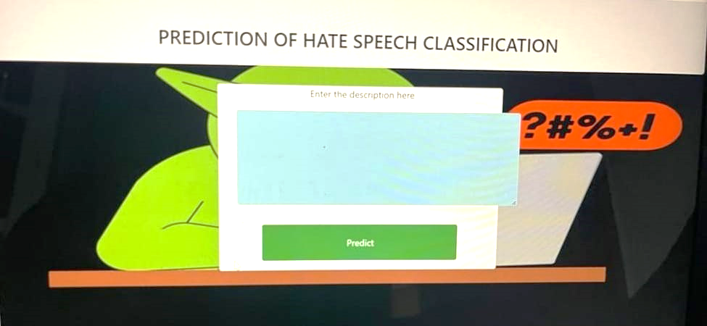

Slide 16
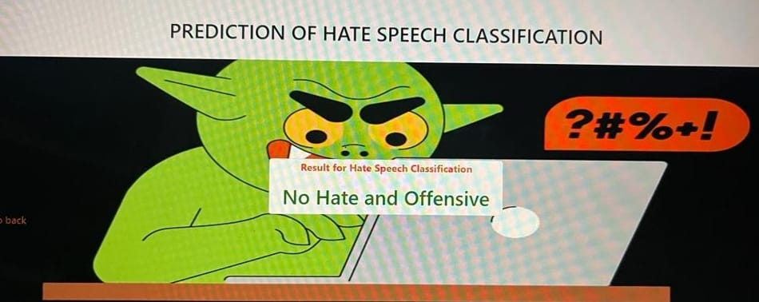

Slide 17
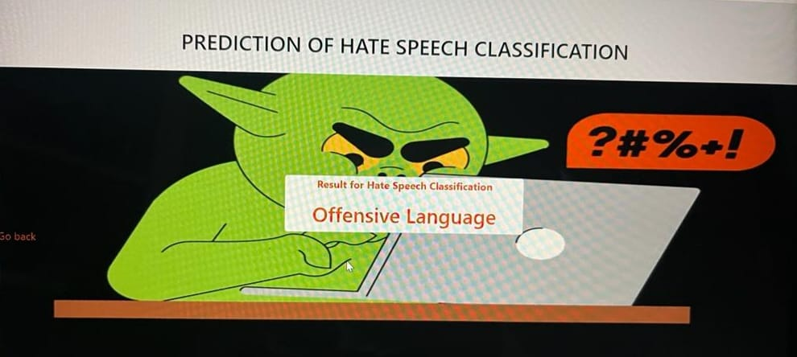

Slide 18
CONCLUSION
The analytical process started from data cleaning and processing, missing value, exploratory analysis and finally model building and evaluation. The best accuracy on public test set is higher accuracy score will be find out. This application can help to find the Prediction of Hate Speech classification.

Slide 19
REFERENCES
[1] X. Glorot, A. Bordes, and Y. Bengio, “Domain adaptation for large- scale sentiment classification: A deep learning approach,” in Proc. ICML, 2011, pp. 513–520.
[2] C. E. Shannon, “A mathematical theory of communication,” Bell Syst. Tech. J., vol. 27, no. 3, pp. 379–423, 1948.
[3] A. Olteanu, C. Castillo, J. Boy, and K. Varshney, “The effect of extremist violence on hateful speech online,” in Proc. Int. AAAI Conf. Web SocialMedia, vol. 12, no. 1, 2018, pp. 221–230.
[4] Z. Zhang, D. Robinson, and J. Tepper, “Detecting hate speech on Twitter using a convolution-GRU based deep neural network,” in Proc. Eur. Semantic web Conf., Heraklion, Greece. New York, NY, USA: Springer, 2018, pp. 745–760.
[5] J. Qian, M. ElSherief, E. M. Belding, and W. Y. Wang, “Hierarchical CVAE for fine-grained hate speech classification,” in Proc. EMNLP, 2018, pp. 3550–3559.
[6] S. Poria, D. Hazarika, N. Majumder, G. Naik, E. Cambria, and R. Mihalcea, “MELD: A multimodal multi-party dataset for emotion recognition in conversations,” in Proc. 57th Annu. Meeting Assoc. Comput. Linguistics, 2019, pp. 527–536.
[7] Y. Zhang, Z. Zhao, P. Wang, X. Li, L. Rong, and D. Song, “ScenarioSA: A dyadic conversational database for interactive sentiment analysis,” IEEE Access, vol. 8, pp. 90652–90664, 2020.

